Slide 1



Day 29
contact@anubhavtrainings.com
ABAP RESTFUL APPLICATION PROGRAMMING

Slide 2

Agenda – Day 29
What is EML ?
Why we use EML
Syntax of EML
C-R-U-D Using EML
Implementation of EML
Introduction to Managed Scenario
Use Case for Managed Scenario
Describing Functionality of Scenario
End to End Development Flow
Create Base CDS Views
Understanding Base Behaviour Definition
Implementation of Base Behaviour Definition
Create Projection CDS View for Processor
Create/Implement Behaviour Definition for Processor
Create Service Definition to Expose Entity
Implement Service Binding

Slide 3
What is EML ?
The Entity Manipulation Language (EML) is a part of the ABAP language that enables access to RAP business objects. Because the consumption of business objects via the OData protocol requires a Fiori UI or a web API, EML enables a type-safe access to business objects directly by using ABAP.
A Business Object in RESTful ABAP is consists of multiple Entities. This is a entity composition tree with one entity acting as a root. EML is part of the ABAP language and used in context of RESTful ABAP to control the BO behavior (create, read, update, delete).
We can use the EML in ABAP to test our BO. We can call the BO using EMP from ABAP program in 2 ways
01
Standard (Statically)
Generically (Dynamic) framework.
02

Slide 4
Syntax of EML
The EML provides us 3 important access statements for Data Manipulation using BO( Business Object ).
01
Perform the CUD ( Create ,Update ,Delete on BO
MODIFY ENTITIES OF RootEntityName
ENTITY EntityAliasName
[ CREATE FROM it_instance_c ]
[ UPDATE FROM it_instance_u ]
[ DELETE FROM it_instance_d ]
[ CREATE BY \AssociationName FROM it_instance_cba ]
[ RESULT et_result_tab ] [ FAILED failed ] [ REPORTED response ] [ MAPPED mapped ]
02
Commit Entities
Will actually persist the changes in the DB from transaction buffer. Any modify operation that are executed within behavior pool or by ABAP program are not causing any DB change because they are applied on transaction Buffer and this buffer content will disappear when ABAP session ends. So if we want the changes to be passed to SAVE SEQUENCE and persisted, we will use the COMMIT ENTITIES statement.
finalize ( )
check_before_save( )
Adjust_numbers( )
Save( )

Slide 5
Syntax of EML
03
Read the Data
All operations that do not need to change the data of an entity are carried out by READ Data.
There 2 types of Read
Read Entity by Key
Read Access to child (association) by parent key
Read Statement always returns the RESULT and you must specify target variable. We can also read the associated entity data using BY \asso_name FROM it_table syntax.
The result of associated data with come in another internal table LINK tab_name, it will always contain the key value pair.
READ ENTITIES OF RootEntityName
ENTITY EntityAlias FROM it_read_condition
RESULT et_result
BY \asso_name FROM it_read_rba
RESULT et_res_rba
LINK et_link_keys
ENTITY EntityAlias FROM it_ins_2…. [ FAILED failed ] [REPORTED reported]

Slide 6

Rule for EML
In addition to the data we also have a compiler generated field in input and output results called %control, this field is responsible to inform the RESTful framework that, which are all the fields we would like to send to DB while creation or update while updating. Also while read we can specify the same to avoid reading everything.
We can also see the complete BO structure in BO Explorer using keyboard shortcut :-
Alt+Shift+W

Slide 7
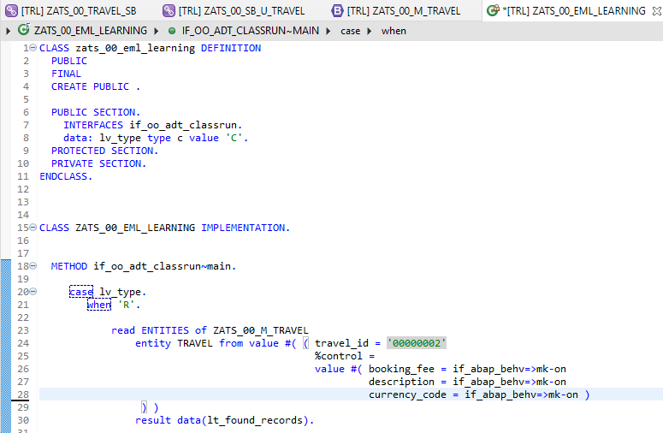
Implementing EML
Exercise
ZATS_00_EML_Learning

Slide 8
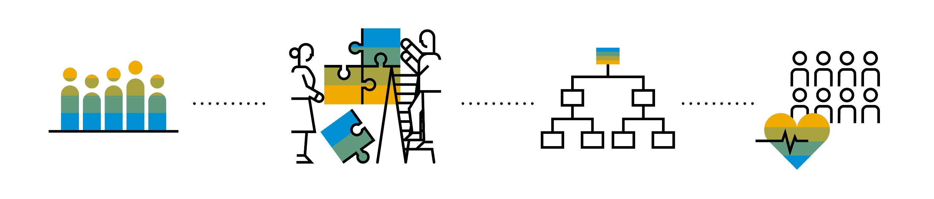
Introduction to Managed Scenario
Let us consider we have been given a green field and asked us to develop a villa from scratch with our own customization. So, what steps will be involved in it? We need to design the floor-plan of the villa, the sections we want to include in the house like pool area, a garden, a jogging track etc. And we will proceed with selecting materials, selecting vendors, enforcing conciliation and orders and many more steps. Similarly, the RAP’s managed scenario provides the greenfield development for our business object.
In the managed scenario, the implementations of behavioral elements like Create/Update/Delete are managed by the RAP framework itself. However, to implement complex logic like validations, determination or some sort of actions (Submit, Approval, Reject etc.) on the business entity, you need to add the ABAP logic for it in implementing classes.

Slide 9
Use Case for Managed Scenario
I am working as a ABAP on Cloud developer for one of the Multi-nationals, which has just taken the SCP subscription. They want me to create 2 fiori apps for the travel industry
Processor Application
Approver Application
MakeMyTrip.com
Source → Destination
Start → End Date
How many
Travel Itinerary
Travel Request which has multiple Bookings
Create a travel request and add bookings with all the properties changeable
Booking fee
Description
Give approval
Processor
Approver

Slide 10

Steps for Build Use Case
Fiori App for Processor
Fiori App for Approver
Service Def and Binding
Service Def and Binding
1
3
CDS Data Model
CDS Projection for Processor @UI
CDS Data Model
CDS Data Model
CDS Projection for Approve @UI
Introduction
1..1
2
Behavior Def
Behavior definition
Behavior definition
Behavior Def
Behavior definition
Behavior Implement (pool)

Slide 11
End to End Development Flow
4. Imp Behavior Definition on top of Projection View’s of Processor App.
7. Imp Behavior Definition on top of Projection View’s of Approver App.
2. Imp Behavior Definition on Travel.
6. Create Service Binding on top of Service Definition.
10. Create Service Binding on top of Service Definition .
1
3
5
7
9
2
4
6
8
10
1. Create Basic CDS View’s
For Travel & Booking.
3. Create Projection CDS on top of Basic View’s for Processor App.
5. Create Service Definition for Processor App.
7. Create Projection CDS on top of Basic View’s for Approver App.
9. Create Service Definition for Approver App.

Slide 12
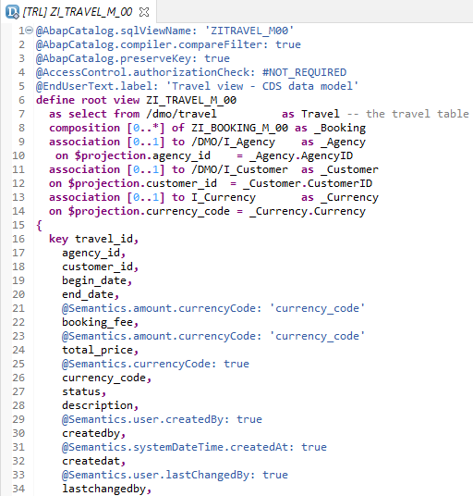
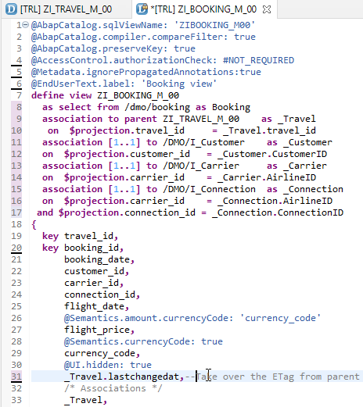
Create Base CDS View
ZI_TRAVEL_M_00
ZI_BOOKING_M_00

Slide 13
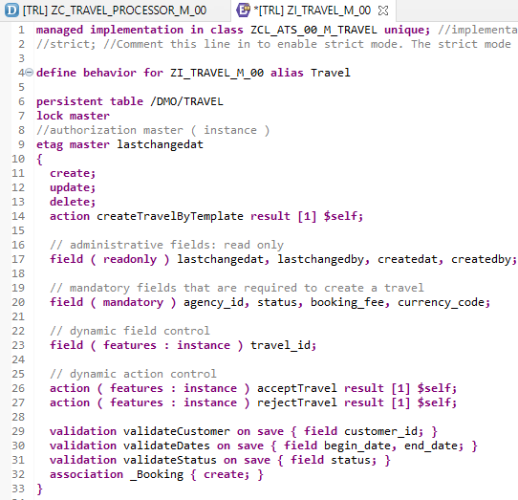
Implementing Base Behavior Definition
z
“ZI_TRAVEL_M_00”
Behavior Definition for Base CDS’s Views .

Slide 14
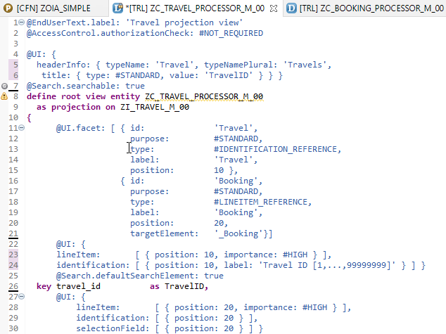
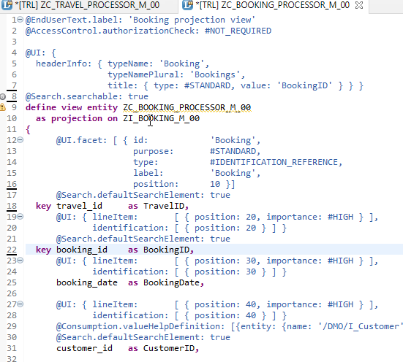
Projection CDS View’s for Processor
Projection CDS View for Travel Info “ZC_TRAVEL_PROCESSOR_M_00”
Projection CDS View for Booking Info “ZC_BOOKING_PROCESSOR_M_00”

Slide 15
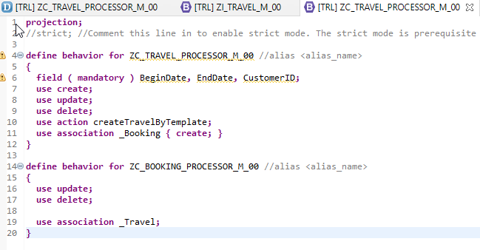
Behaviour Definition for Processor
“ZC_TRAVEL_PROCESSOR_M_00”
Behavior Definition for Projection CDS’s Views of Processor.

Slide 16
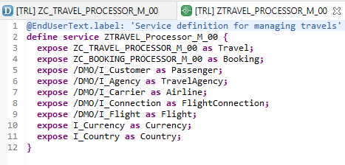
Service Definition
“ZTRAVEL_PROCESSOR_M_00”
Service Definition for Expose Entity

Slide 17
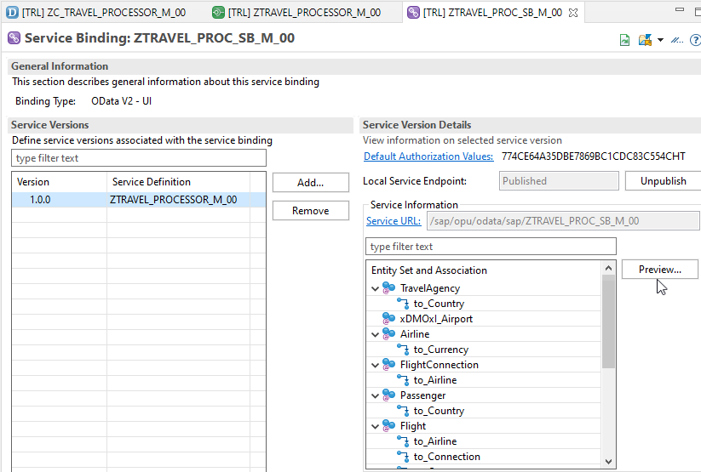
Service Binding (OData)
After Creating Service Binding , Select Entity and Click on Preview

Slide 18
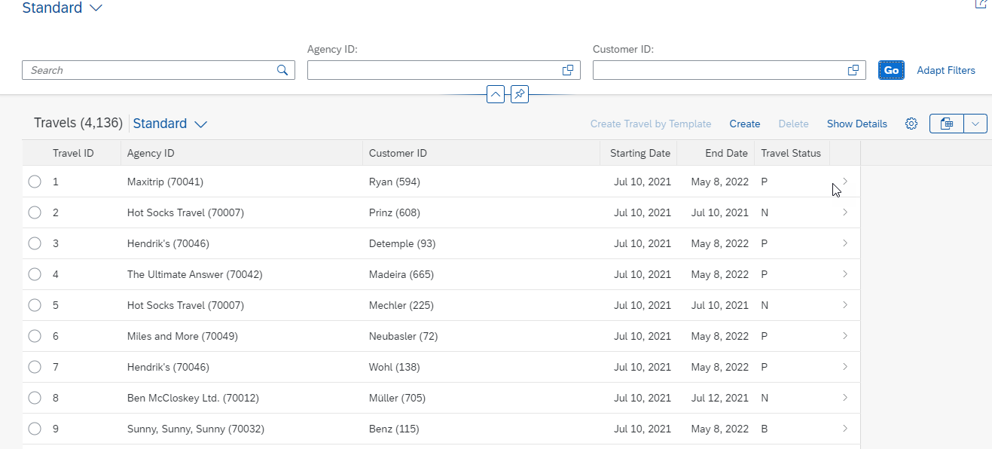
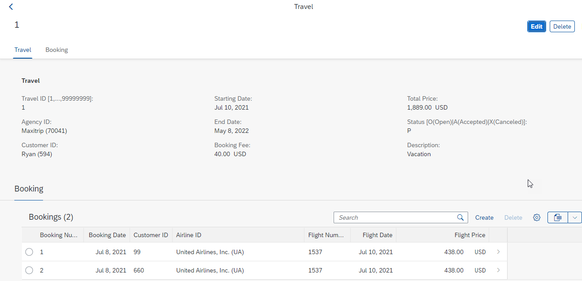
Final Result of Processor App
1st Screen with Search Bar & Filter Bar
2nd Screen with Travel and Booking Data,
& C-R-U-D Functionality

Slide 19

End of Day 29
Trainer: Anubhav Oberoy

Slide 20

Trainer: Anubhav Oberoy

Slide 21
THANK YOU
If you cannot do
great things, do small things in a great way.
Anubhav Oberoy
https://www.anubhavtrainings.com

Slide 22


We’re committed to empower you to be
Most Desirable Resource
through powerful training solutions.
We build the workforce of the future.
250+
Corporate Clients
30,000+
Learners Trained
25000+
Learners Placed
FREE WEBINARS
Sign up for free webinars with industry experts every fortnight!
Enroll Now!
Contact us today!
https://anubhavtrainings.com/

Slide 23




More from AnubhavTrainings.com

